Slide 1


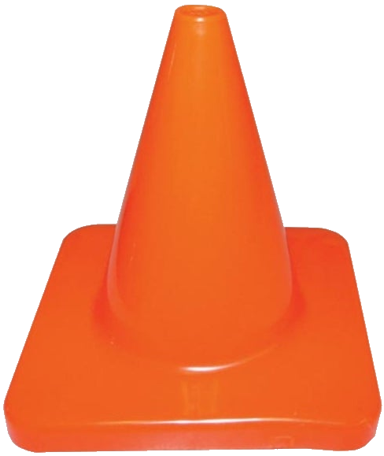



 | Renton Fish & Game Club Bay 4 Stage: Scatterbrain Joe Course Designer: Kris Erickson
“If you want to protect yourself, get a double-barreled shotgun, have the shells of 12-gauge shotgun, and I promise you, as I told my wife...I said, 'Jill, if there's ever a problem, just walk out on the balcony here, walk out, put that double barreled shotgun and fire two blasts outside the house. I promise you whoever's coming in is not going to. You don't need an AR-15.’” – Joe Biden, February 20, 2013. SCENARIO: You are Jill Biden (our condolences). Despite heeding your senile husband’s advice to take that double barreled shotgun outside and “fire two blasts”, the bad guys continue their advance. Smack the closest bad guy with the now empty shotty, then whip out your pistol and get to business. (REMEMBER: When seconds count, the Secret Service is only minutes away.)
START POSITION: Standing at P1, toes on marks. Handgun loaded and holstered. PCC loaded, stock on belt muzzle pointed at cone. |  | STRINGS: 1 SCORING: Unlimited SCORED HITS: Best 2 ROUND COUNT: 12 TARGETS: 6 IDPA, 1 NT, 1 PP START-STOP: Audible - Last shot CONCEALMENT: Required Muzzle Safe Points: 180 degree rule SO NOTES:
STAGE PROCEDURE: At the start signal, kick over PP1. Engage T1-T3 in the open. Move to P2 and engage T4-T6. NOTES:
T3
T2
T5
T6
T1
T4
NT Corgi
PCC
Cone
Sleepy Joe’s
Romance-a-torium
P2
P1
https://www.youtube.com/watch?v=CrzyRXSxuAg

